Slide 1
Secure Data Hiding in image Using Stedanography
CAPSTONE PROJECT
Presented By: Priya Dharsini E
Student Name : Priya Dharsini E
College Name & Department : Kamaraj College of Engineering and Technology -ECE

Slide 2
OUTLINE
Problem Statement
Technology used
Wow factor
End users
Result
Conclusion
Git-hub Link
Future scope

Slide 3
Problem Statement
With the increasing risk of data breaches, secure communication methods are essential. Traditional encryption methods make data protection possible but can attract unwanted attention from attackers. Steganography allows hiding sensitive information in images, making it difficult for attackers to detect or intercept.

Slide 4
Technology used
Libraries OpenCV
Platforms Python

Slide 5
Wow factors
High-security encryption before embedding.
Minimal impact on image quality.
User-friendly interface for encoding and decoding
Invisible Data Embedding
Dual-Layer Security (Encryption + Steganography)
Hard to Detect & Trace.

Slide 6
End users
Government agencies
Journalists
Corporate entities
Cybersecurity & Digital Forensics
Individuals needing confidential communication

Slide 7
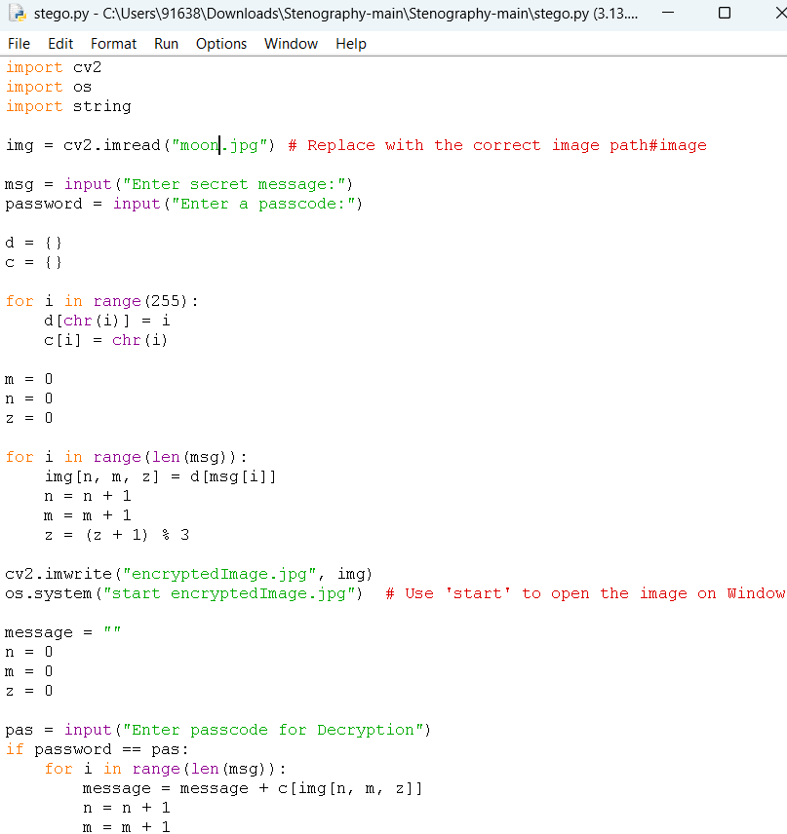
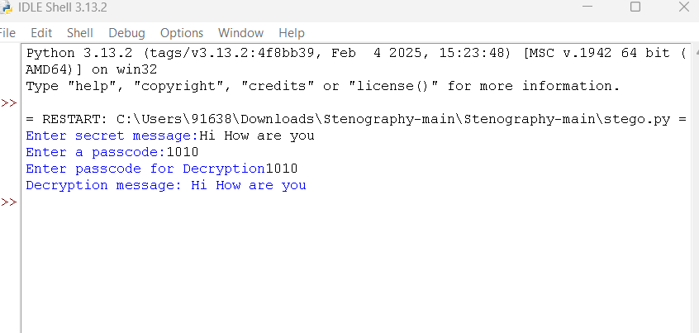

Results

Slide 8
Conclusion
This project ensures secure data transmission by embedding secret information in images using steganography. It provides an additional layer of security in digital communication

Slide 9
GitHub Link
https://github.com/Abipriya1010/Stenography.git

Slide 10
Future scope(optional)
AI-based detection resistance.
Blockchain for tamper-proof security.
Mobile app integration.

Slide 11
THANK YOU

